Slide 1
Homework #3: due 5:00 pm, Tuesday 9/20
Exam 1: Date changed to Sept. 28 (was 9/26)
Grades will be posted in View’em (not Grades) for the rest of the semester.
Groups have been assigned their Exoplanetary system (will appear in View’em), instructions coming soon.

Slide 2
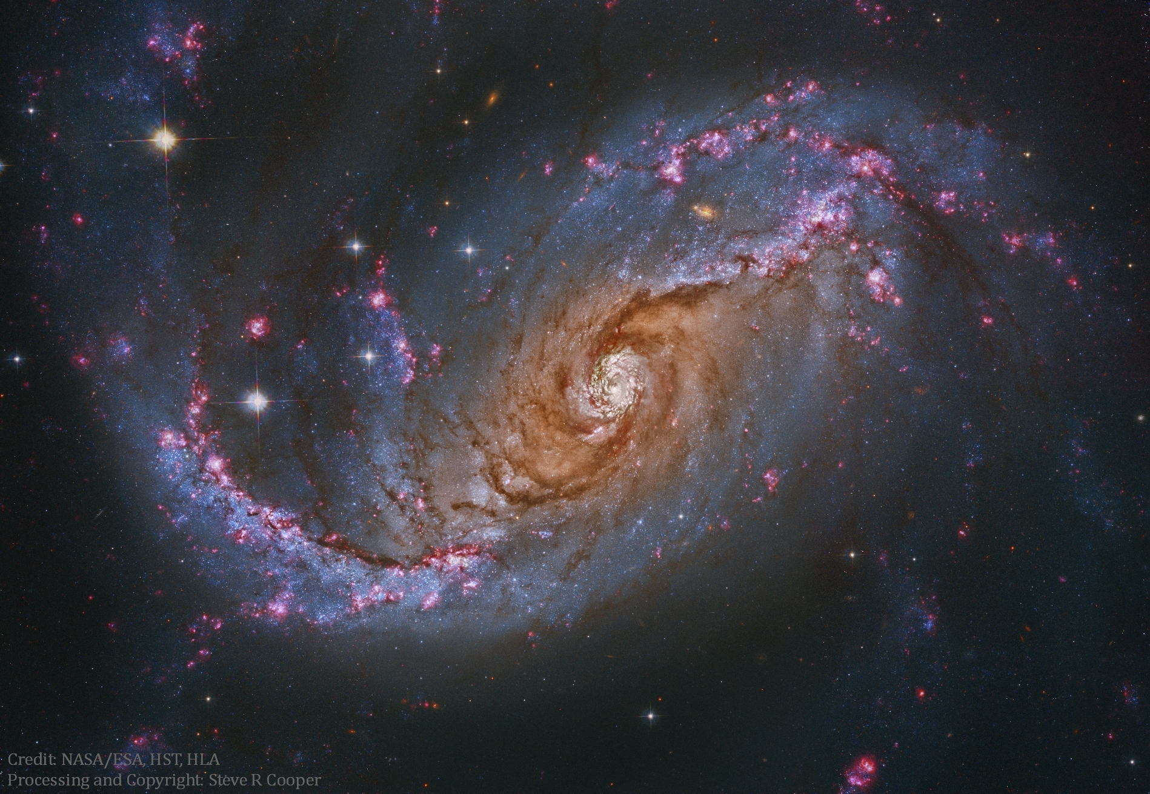
We are “star stuff”
Notes:
NGC 1672 – barred spiral galaxy. Dust, young hot stars (blue), star forming regions (red “emission” nebula of glowing hydrogen gas. We are “star stuff”

Slide 3
Newton's Laws of Motion
Explains how motion and forces are connected.
To understand motions in the sky, we must understand the forces that are involved.

Slide 4
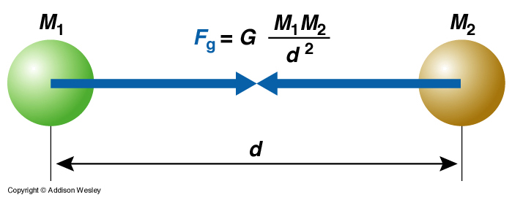
Universal Law of Gravitation
Between every two objects there is an attractive force, that is proportional to the masses of each object and inversely proportional to the square of the distance between the centers of the objects.

Slide 5

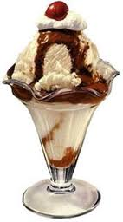
M₁
M₂
This force is always attractive and it applies to ALL objects possessing mass!

Slide 6
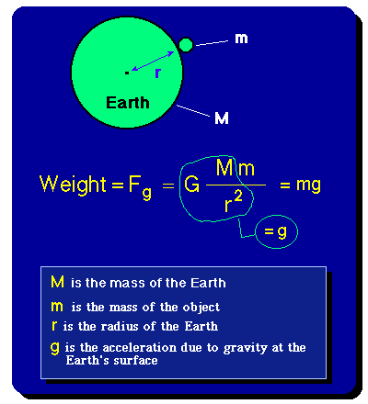
Weight is the force due to gravity that acts on a given mass Weight = F_{g} = mg where g is the acceleration due to gravity.

Slide 7
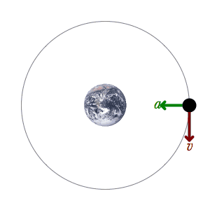
An orbiting planet is always changing its direction of motion.
Newton’s second law states that a force must be acting on the planet.
Gravity provides this force.
Motion without an applied force
Force due to gravity

Slide 8
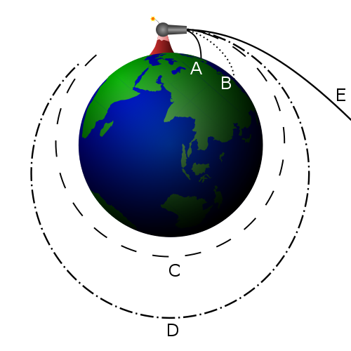
Motion with no gravity
Slowest cannonball
A cannonball’s motion is curved as it moves forward while, at the same time, it falls towards the Earth.
fastest cannonball

Slide 9
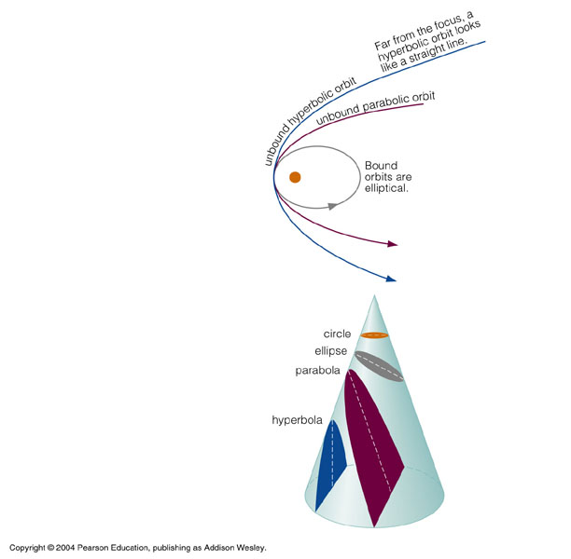
Orbital Paths from Law of Gravitation
All orbits are “conic sections”
ellipse (bound)
parabola (unbound)
hyperbola (unbound)
Extending Kepler’s First Law, Newton found that ellipses were not the only orbital paths.

Slide 10
The Center of Mass
In Kepler's Laws, the Sun is fixed at a point in space (a focus of an ellipse) and the planet revolves around it.
Why is the Sun privileged?
Kepler had mystical ideas about the Sun, endowing it with almost god-like qualities that justified its special place.
Newton demonstrated that the the Sun does not occupy a privileged position and in the process he modified Kepler's 1st and 3rd Laws.

Slide 11
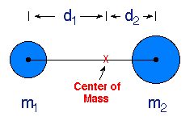
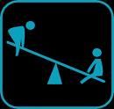
The center of mass is familiar to anyone who has ever played on a see-saw. The fulcrum point at which the see-saw will exactly balance two people sitting on either end is the center of mass for the two persons.
m₁d₁ = m₂d₂

Slide 12
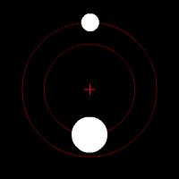
Newton realized that in the planet-Sun system the planet does not orbit around a stationary Sun (a planet exerts as much gravitational force on the Sun as the Sun does on a planet).
Center of mass
F_{g} = Gm₁m₂/d²
Instead, Newton proposed that both the planet and the Sun orbited around the common center of mass for the planet-Sun system.

Slide 13
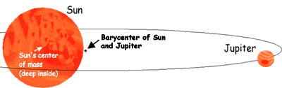
Sun
Jupiter
Center of mass (barycenter) of Sun & Jupiter

Slide 14
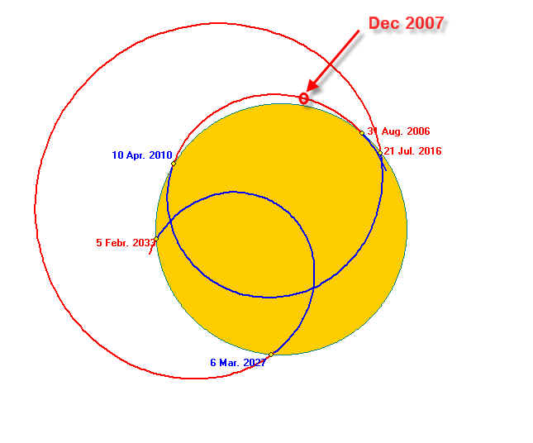
Center of mass:
Sun & the 8 planets
2006 - 2033

Slide 15
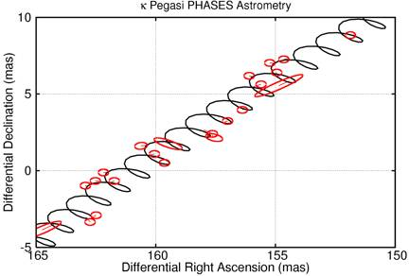
Exoplanet induced motions of star

Slide 16
Kepler’s Third Law
The Law of Universal Gravitation and the realization that planets & the Sun orbit their mutual center of mass allowed Newton to modify Kepler’s Third Law:
P² = a³ / constant
Newton’s modification
P² = 4π² a³ / G (m₁ + m₂)
G is known as the universal gravitational constant.
If you can measure the orbital period of two objects (P) and the size of their orbit (a),
then you can calculate the sum of the masses of both objects (m₁ + m₂)

Slide 17
Energy
The history of the Universe and the nature of life is governed by the interplay between matter and energy

Slide 18
Matter – material such as rocks, water, air; “stuff” composed of atoms
Energy – makes or has the potential to make matter move!
The history of the universe, including biological organisms, is based upon the interplay between matter and energy.

Slide 19
Three Basic Types of Energy
kinetic
energy of motion
potential
stored energy; e.g., chemical, gravitational, electrical, etc.
radiative
energy transported by light (electromagetic radiation)

Slide 20
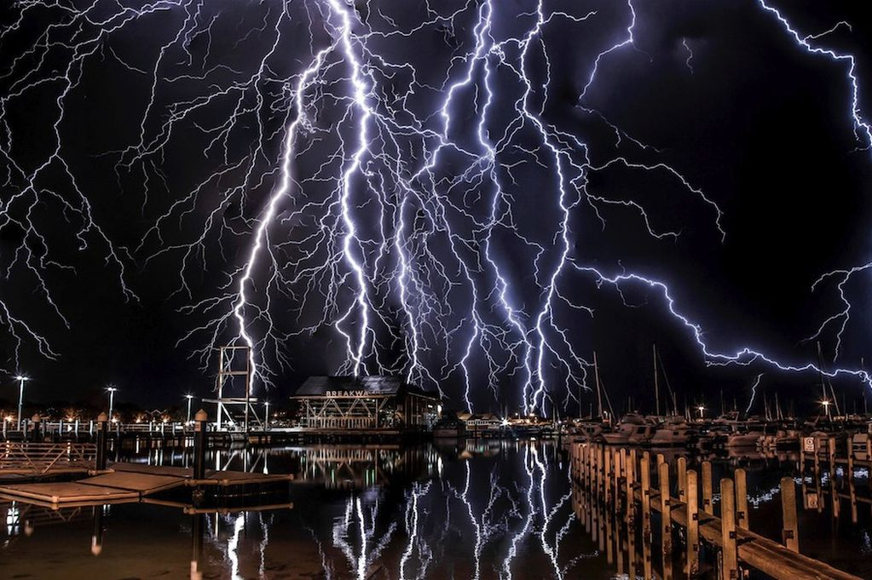
Conservation of Energy
Fundamental law of nature
Energy can be neither created nor destroyed
It can change form or be exchanged between objects.
The total energy content of the Universe was determined in the Big Bang and remains the same today.
K.E.
P.E.
R.E.

Slide 21
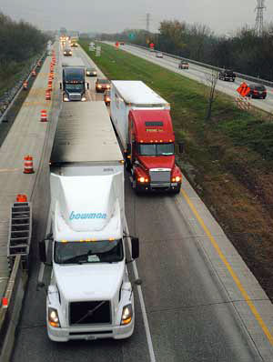
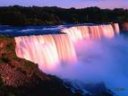
Kinetic Energy (K.E.):
energy of motion
K.E. = 1/2 mv²
^{(m is mass, v is velocity)}

Slide 22
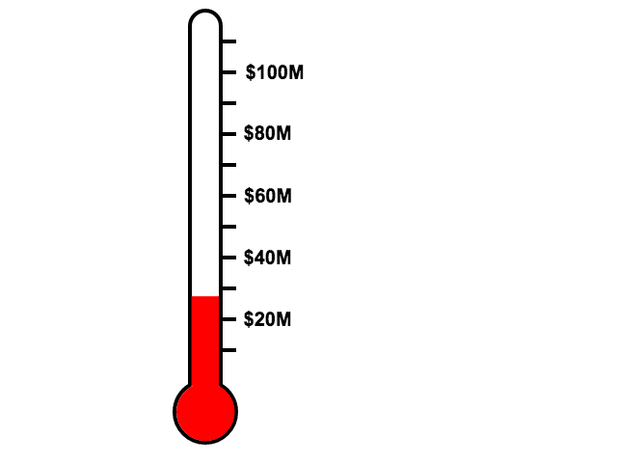
On the microscopic level:
Temperature (T)
is a measure of the
average kinetic energy (KE_{avg})
of particles within a substance

Slide 23
On the microscopic level:
KE_{avg} = (1/2 mv²)_{avg} = 3/2 kT
At a given temperature, less massive particles will be moving faster than more mass particles

Slide 24
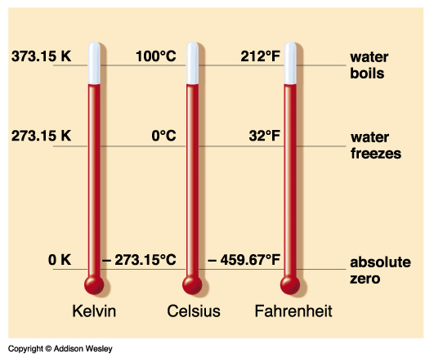
Temperature Scales

Slide 25
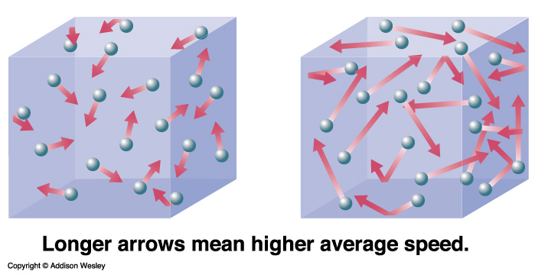
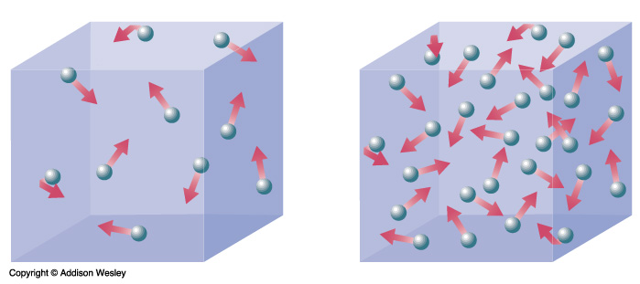
Temperature vs. Heat
Temperature: average kinetic energy.
Heat (thermal energy): total kinetic energy.
lower T
higher T
less heat
more heat
same T

Slide 26
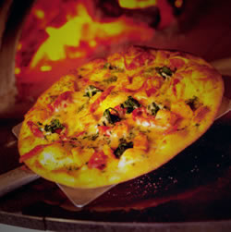
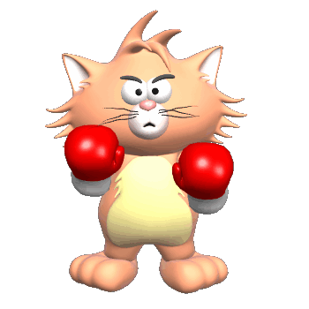
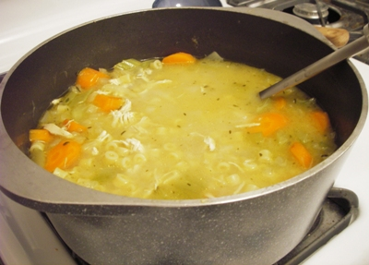
Applying what we’ve learned - pizza vs. soup
caution in the kitchen

Slide 27
Potential Energy: Energy that is “stored” within an object and that has the potential of being released in a different form

Slide 28
Gravitational Potential Energy
gravitational potential energy is the energy which an object stores due to its ability to fall
It depends on:
the object’s mass (m)
the strength of gravity (g)
the distance which it can fall (d)
m
g
d
P.E. = mgd

Slide 29
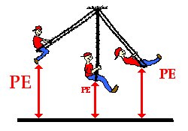
gravitational potential energy
g
P.E. = mgd

Slide 30
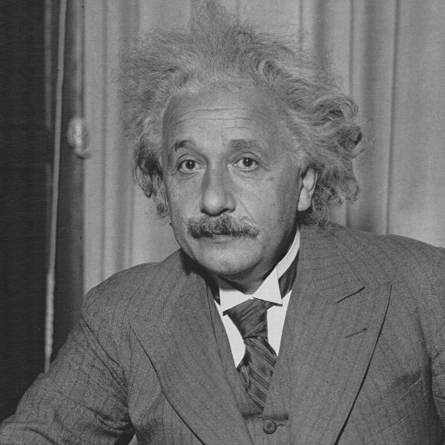
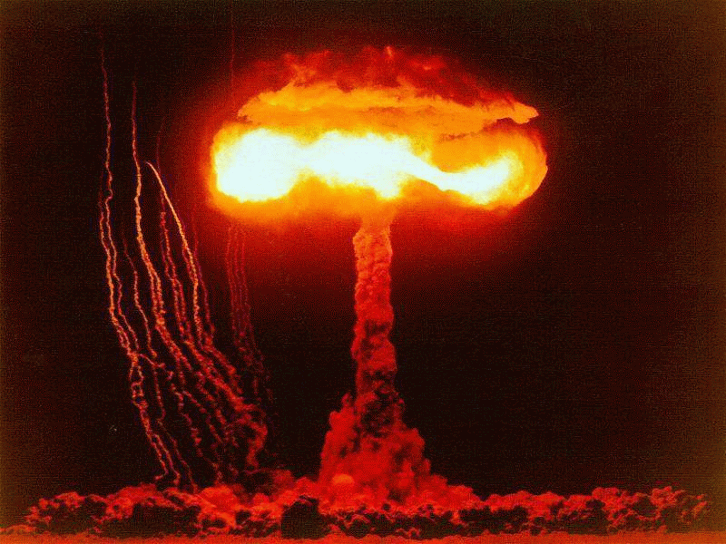
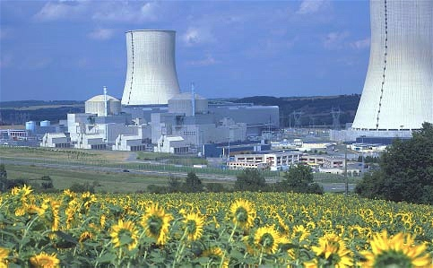
Mass-Energy Potential Energy
mass-energy: energy is stored in matter itself
this mass-energy is what would be released if an amount of mass, m, were converted into energy
E = mc²
[ c = 3 x 10⁸ m/s
is the speed of light]

Slide 31
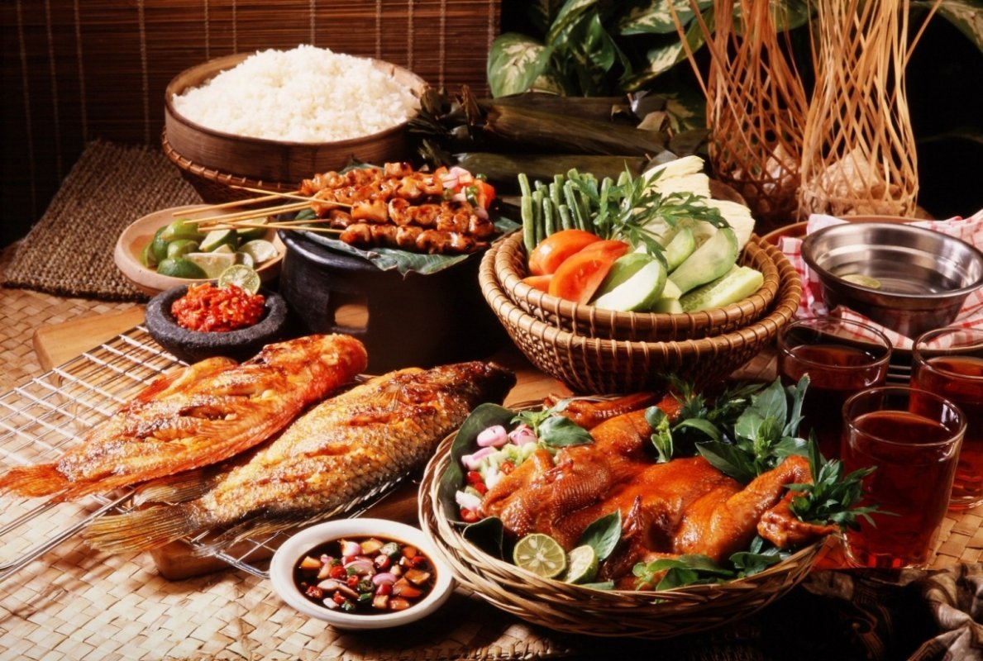
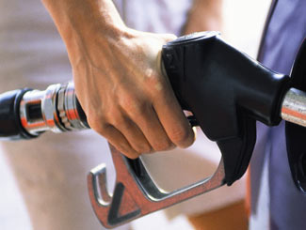
Chemical Potential Energy
Chemical potential energy: energy stored chemical bounds

Slide 32
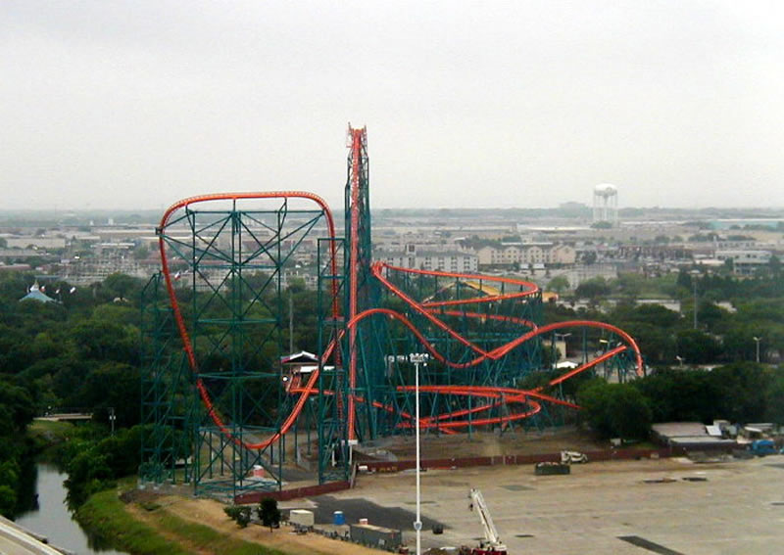
Kinetic Potential

